Slide 1


TECH_TITANS
Presentation Design

Slide 2
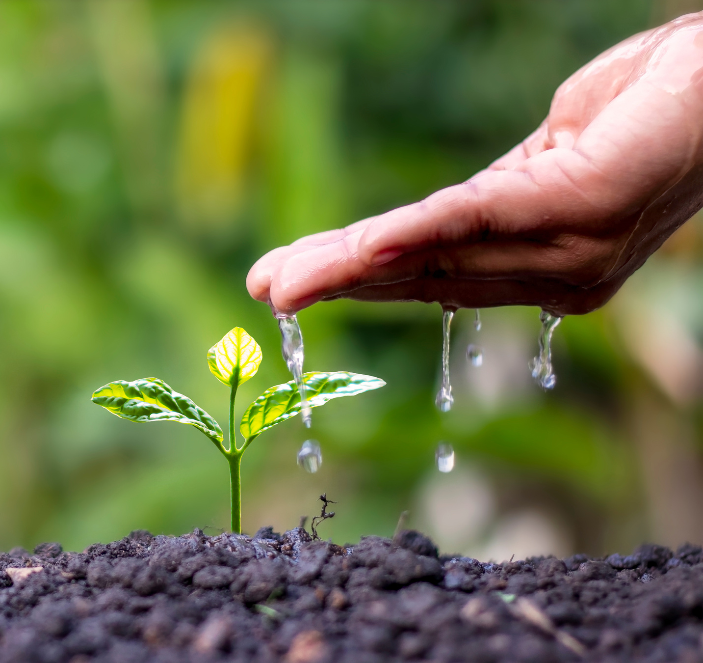
Our Feature
We build a search panel that will link to google maps.
It will show the growth and current structure of the soil
Presentation Design

Slide 3

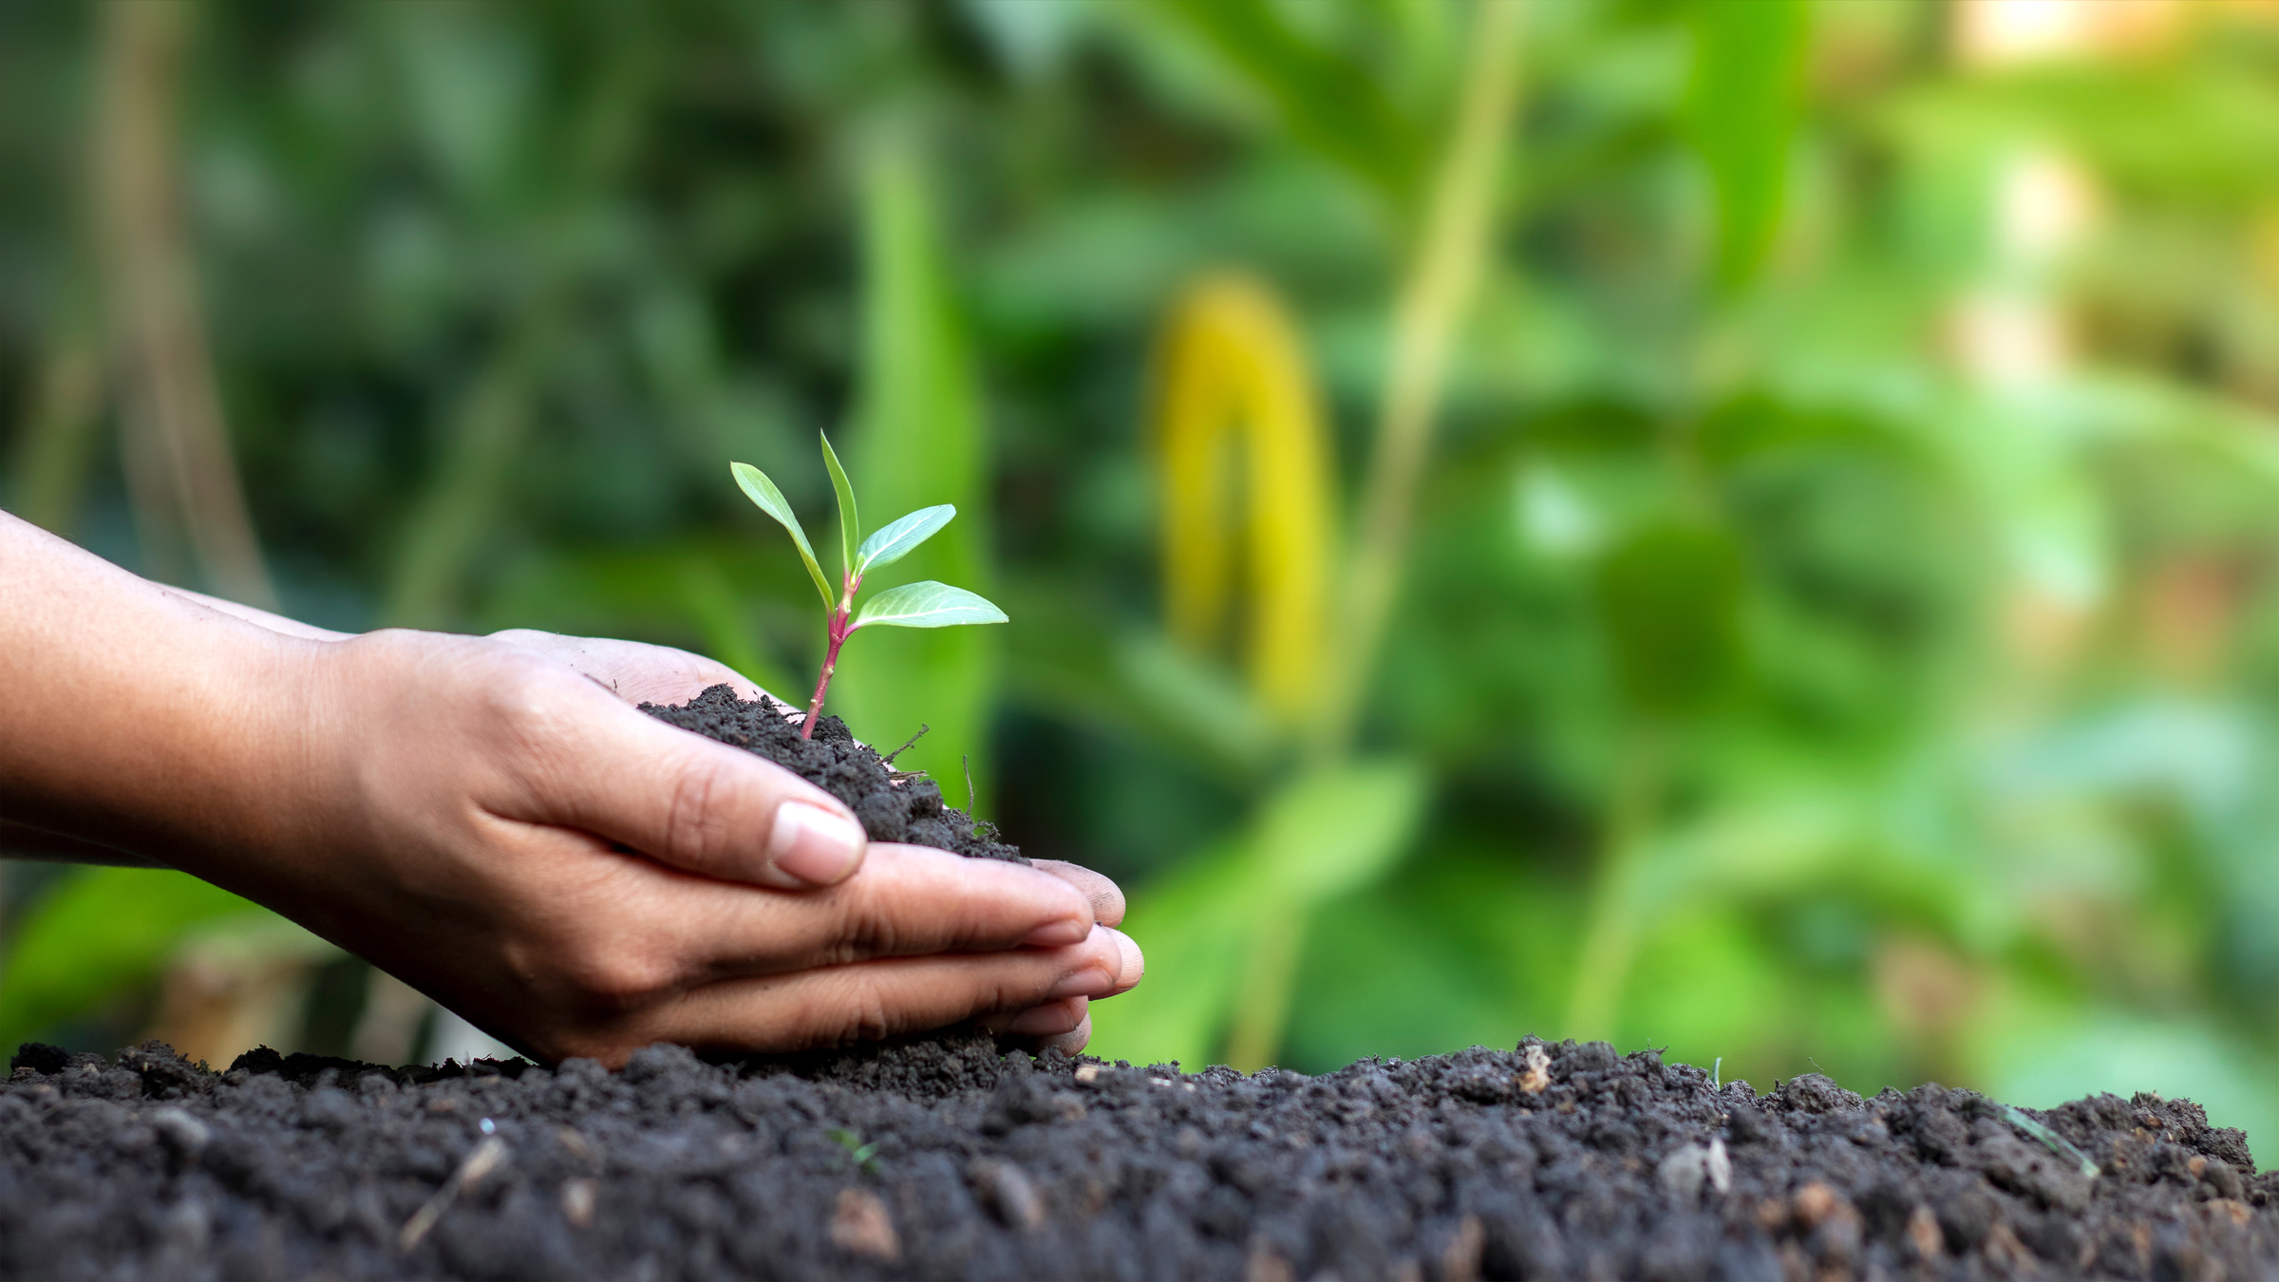
OBJECTIVE
To find current growing crop on the soil
To validate which crop to grow
To show valuable information regarding section of area
Presentation Design

Slide 4
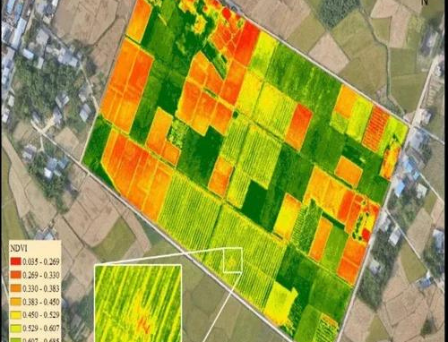
Rimberio Co
THE SOLUTION
It will solve similar to google maps
traffic assessment features.
It will be a pictorial representation
of the data of the selection.
Presentation Design

Slide 5


Rimberio Co
A major USP to create a business.
Presentation Design

